Slide 1
General Guidelines for Presentation
Slides should not be too heavy with content. Better to create point wise.
If you require more than one slide for any point, right click on that point slide then select duplicate slide and modify the duplicated slide.
Diagrams must be aligned at centre and clearly visible with caption.
All the mentioned fonts, font size, title content, etc should not change and strictly as per the given format and guidelines.

Slide 2

E-Commerce app(Myntra clone)
Sahil Sawant (20104006)
Adarsh Rai (20104039)
Sahil Jadhav (21204013)
Project Guide
Prof. Ms. Sonal Balpande

Slide 3
Contents
Introduction
Objectives
Scope
Literature Survey
Proposed System
Project Outcomes
Block Diagram
Use Case/DFD
Technology Stack
Suggestions in Review-1
Result and Discussion
Conclusion

Slide 4
1. Introduction
An e-commerce website is one that allows people to buy and sell physical goods, services, and digital products over the internet rather than at a brick-and-mortar location. Through an e-commerce website, a business can process orders, accept payments, manage shipping and logistics, and provide customer service. The term “e-commerce” simply means the sale of goods or services on the internet. In its most basic form, e-commerce involves electronically transferring funds and data between 2 or more parties.

Slide 5
2. Objectives
To reach more customers and buy that increase sale is business.
To enable customers for quick and easy find of the best solution for their needs to deliver better results consistently.
To cut on traditional costs by reducing the need to respond to every request manually.
To help clarify things like top selling products, least selling products and so on.

Slide 6
3. Scope
1. Can be expanded on a large scale as by 2040 in about some 18 years from now almost 95% of all purchases will be through e-commerce.
2. Can be B2B or B2B C2B Offering.
3. Can be more convenient to launch a app in the coming future which will provide customers more personalized experience than website

Slide 7
4. Literature Survey
Our study focuses on the correlation between e-commerce, culture, and website design, and the article begins with a literature review mostly related to these areas.
The article introduces the literature review, including 4 types of literature review methods, and research methodology for this paper, followed by the resulting outcomes, findings of new significance, and limitations.
Finally, the our research is summed up in a conclusion. Thousands of local and global networks including private, public, academic, business, and government networks, all contribute to the creation of the Internet (Times. 2014).

Slide 8
5. Proposed System
The aim of E-commerce recommendation is to take advantage of Ecommerce site to provide information and suggestion, to help consumers make right choices. An E commerce system is a process in which people (specifically customers) are being provided with the option of purchasing goods and services directly from the seller, all in a real-time environment. Online shopping is an application of the internet as electronic commerce. From the business perspective, customers usually find the products more attractive, on websites, as they get all the details available there.

Slide 9
6. Outcome of Project
User can choose through various variety
User can reach out to new customers
Insights on customer data
Serving the niche market

Slide 10
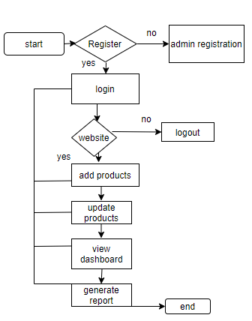
7. Block Diagram
Customer management

Slide 11
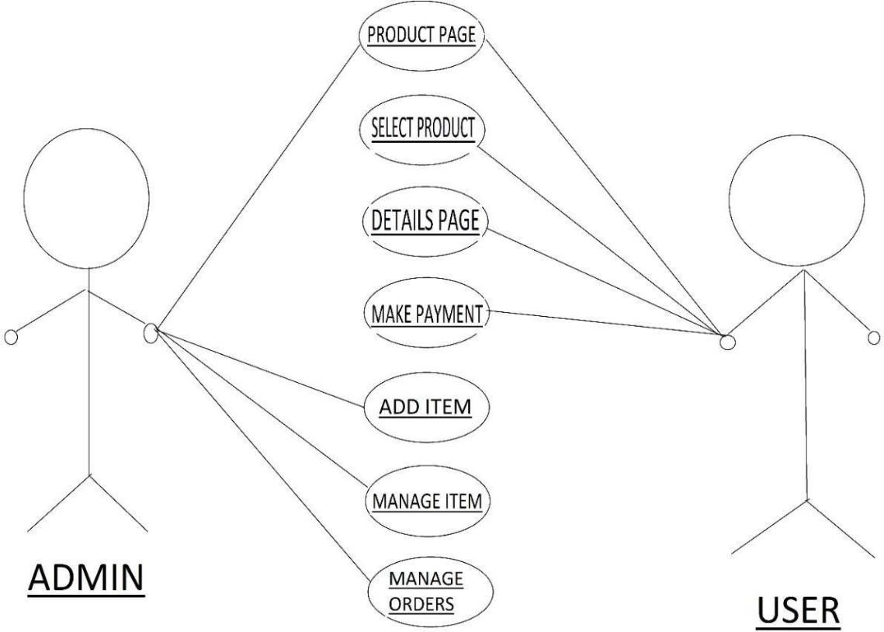
8. Use Case/Data Flow Diagram

Slide 12
9. Technology Stack
1.React.js
2.Stripe
3.Sanity

Slide 13
Suggestions in Review-1
Add a cart
Add Payment method
Proper explanation of ppt

Slide 14
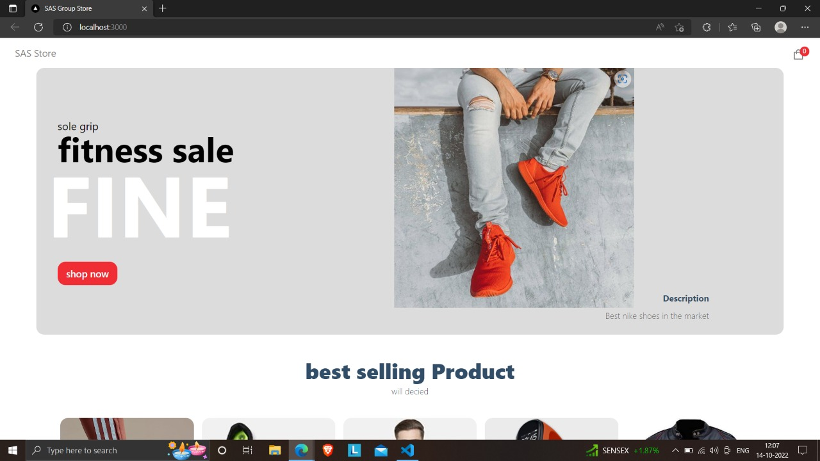
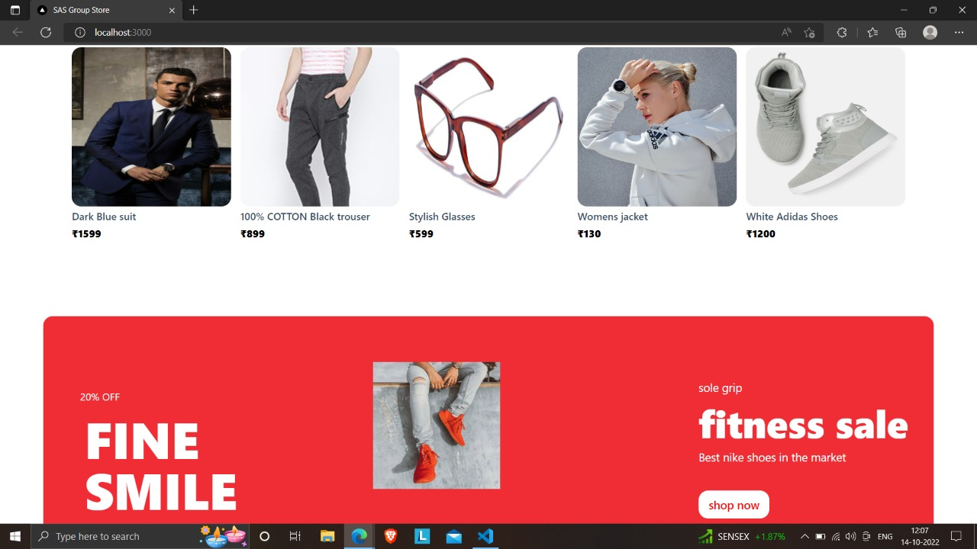
Result and Discussion

Slide 15
Conclusion and Future Scope
Conclusion : E-Commerce is not just an IT issue but a whole business undertaking. Companies that use it as a reason for completely re-designing their business processes are likely to reap the greatest benefits. Moreover, E-Commerce is a helpful technology that gives the consumer access to business and companies all over the world.
Future Scope: E-Commerce is buying and selling, marketing, servicing delivery and payment of products, service and information over internet, intranets, extranets and other networks, between an inter-networked enterprise and its prospects, customers suppliers and other business partners.

Slide 16
Thank You...!!

